Slide 1
ARTICOL DE CERCETARE
The Effects of Workspace Ergonomics on Programmers
Andrei Mihai Cosmin
Szocs Mihaela Felicia

Slide 2
abstract
Ergonomics, positioning and posture of body and design of workstations in offices are considered key research areas in recent times. There is a wide gap in practice and theory of ergonomics. The goal of this study is to evaluate the musculoskeletal health of the employees with relevance to ergonomics and workstation design in practical environment of software houses.

Slide 3
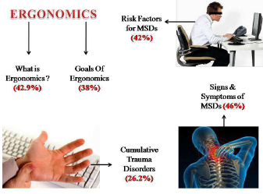
STATE OF THE ART
Knowledge of Computer Ergonomics
- the section related to knowledge
about musculoskeletal disorders and its risk factors
composed of 3 Multiple Choice Questions (MCQ)
- analyzes knowledge regarding ergonomics through a questionnaire administered to 177 students from a private software engineering faculty.
- the questionnaire consisted of 35 items
related to knowledge about musculoskeletal disorders
and its risk factors, working postures, seating, keyboard/
mouse, monitor, table and accessories and finally rest
breaks and exercises.

Slide 4
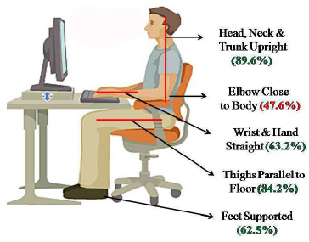
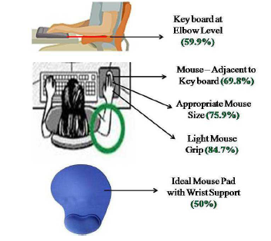
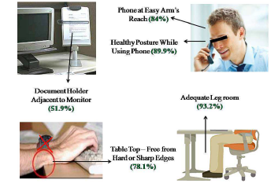
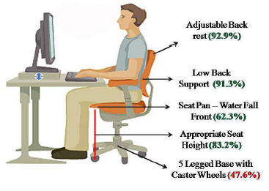
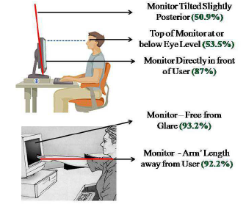
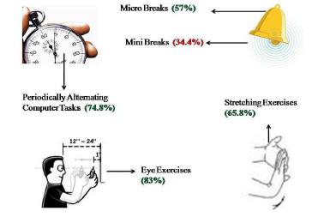
Results of the study

Slide 5


Our study
2 steps
sOCIO-DEMOGRAPHIC
CHARACTERISTICS OF PARTICIPANTS
- questionnaire - similar to the previously discussed study, such as
comfort regarding the chair, lighting, temperature, and desk
organization. The questions are rated on a scale from 1 to
5 and reflect the participants’ opinions on how they carry
out their activities in the workspace.
-we extend the research to the direct
evaluation of performance in a deficient ergonomic environment, followed by an assessment in an optimally ergonomic working environment.
- Gender Distribution of Participants
- Age Distribution of Participants
- Educational Level of Participants
- Experience in the Programming Field

Slide 6
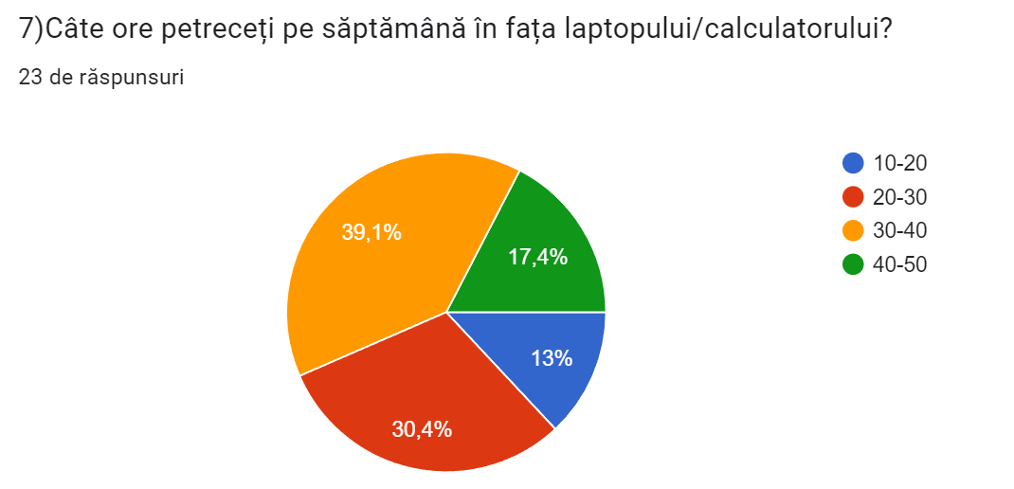
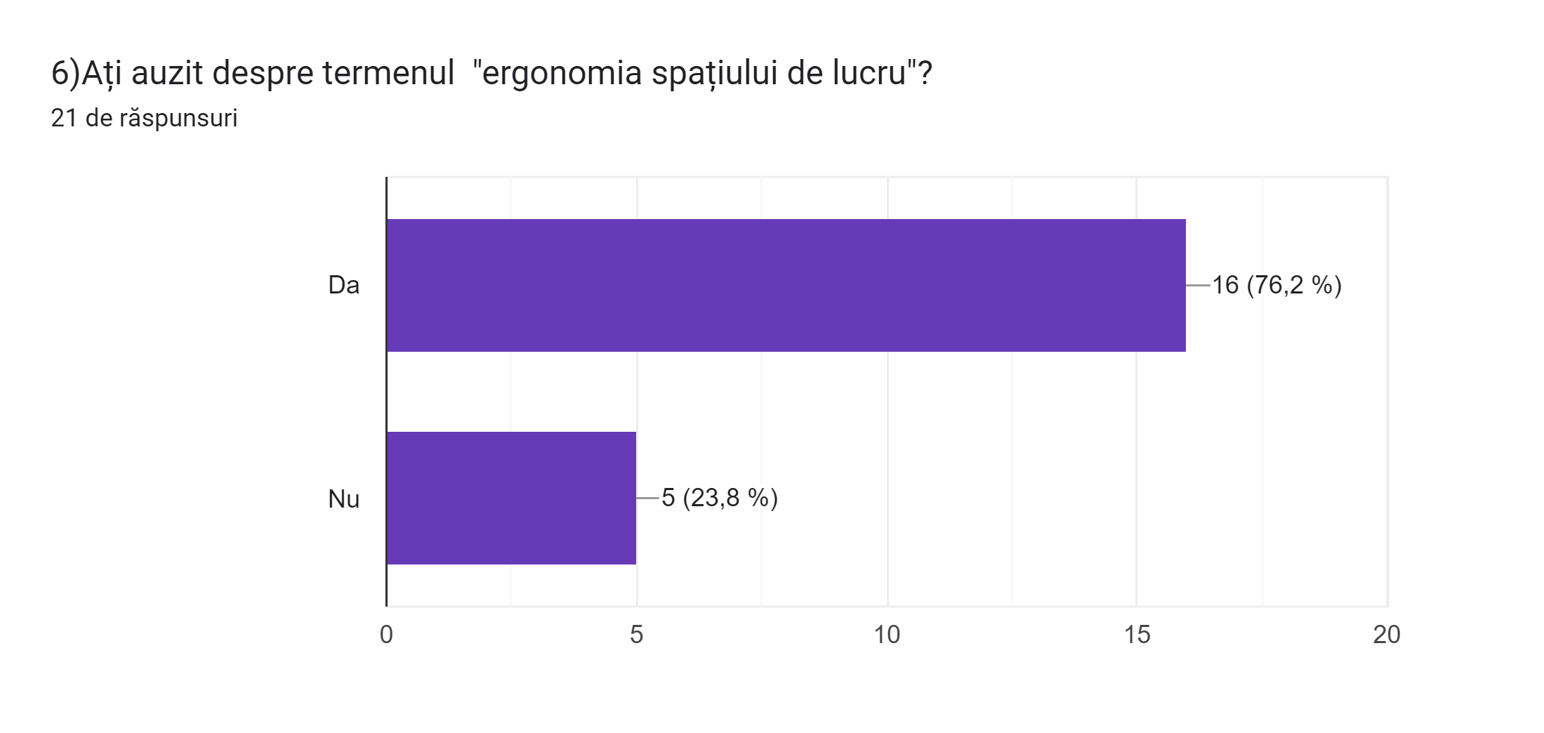
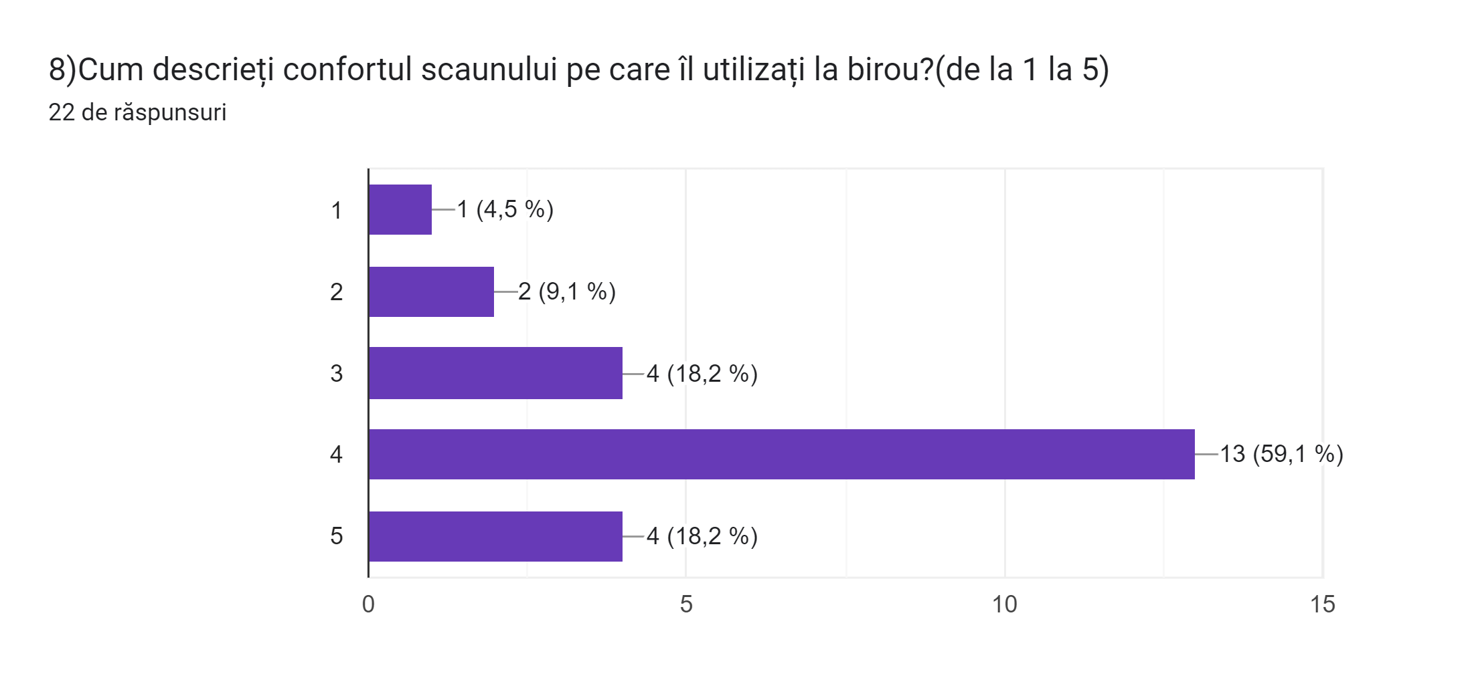
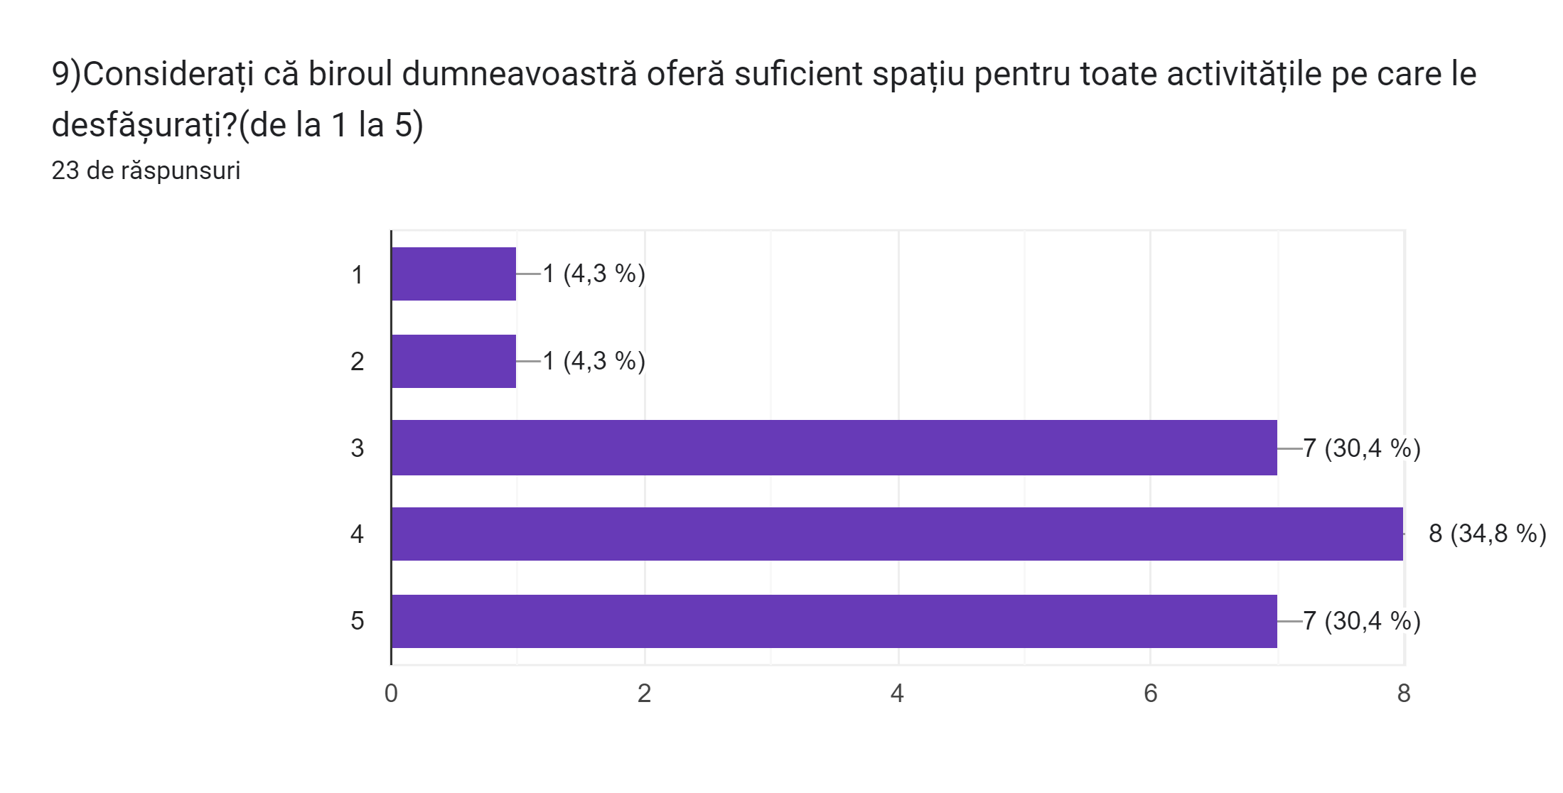
Results of our study- questionnare

Slide 7
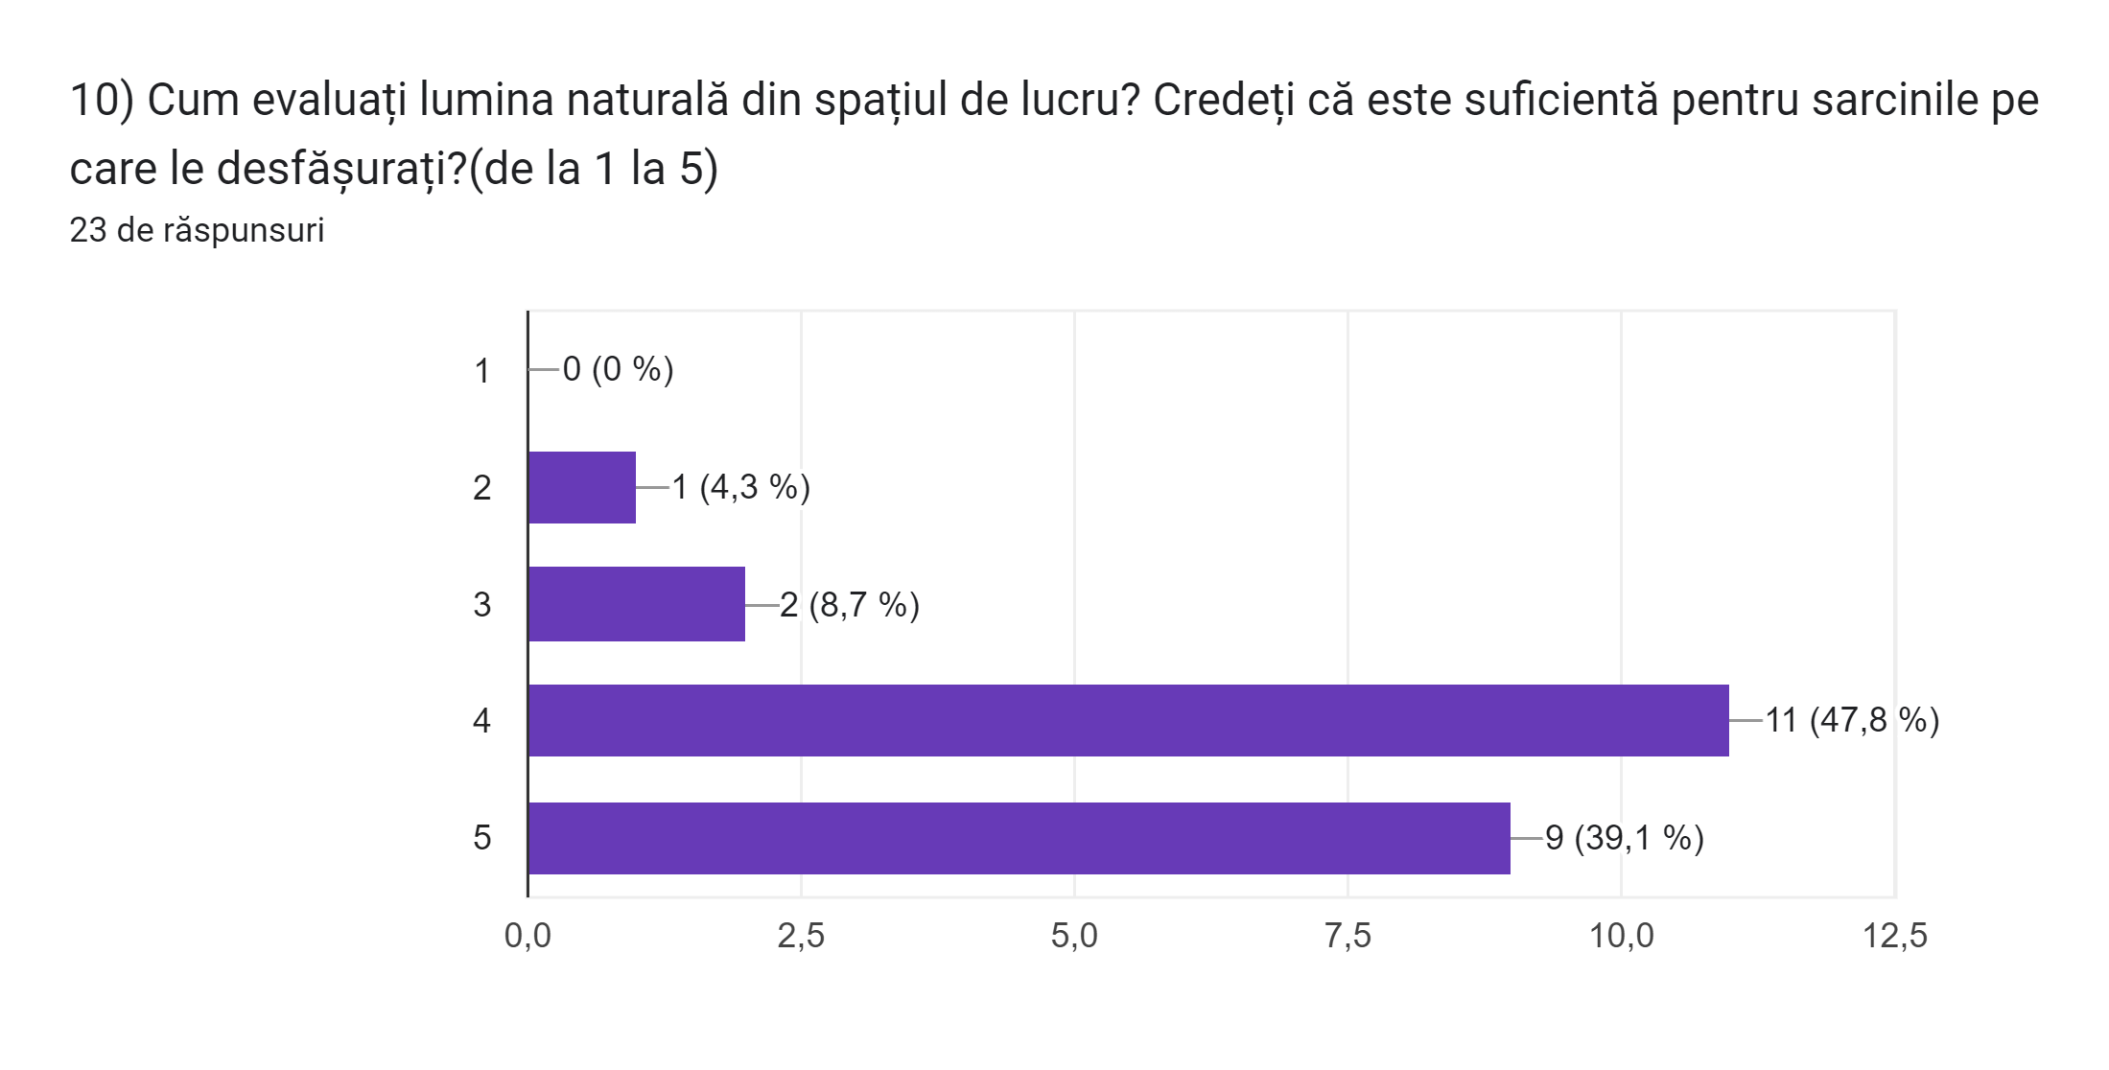
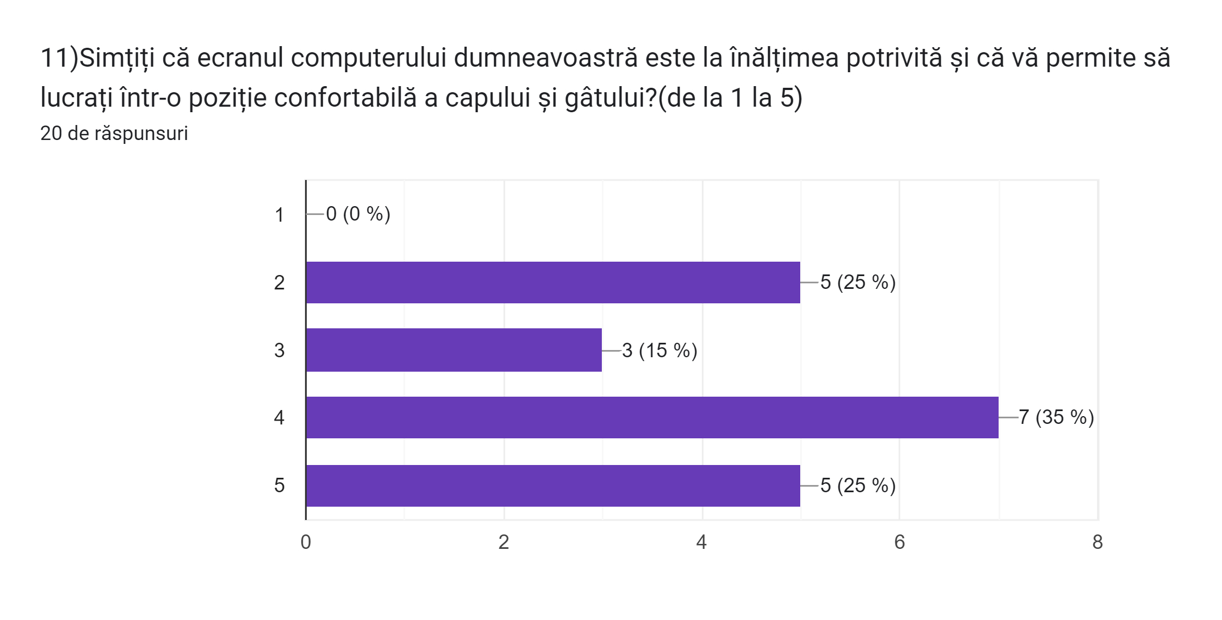
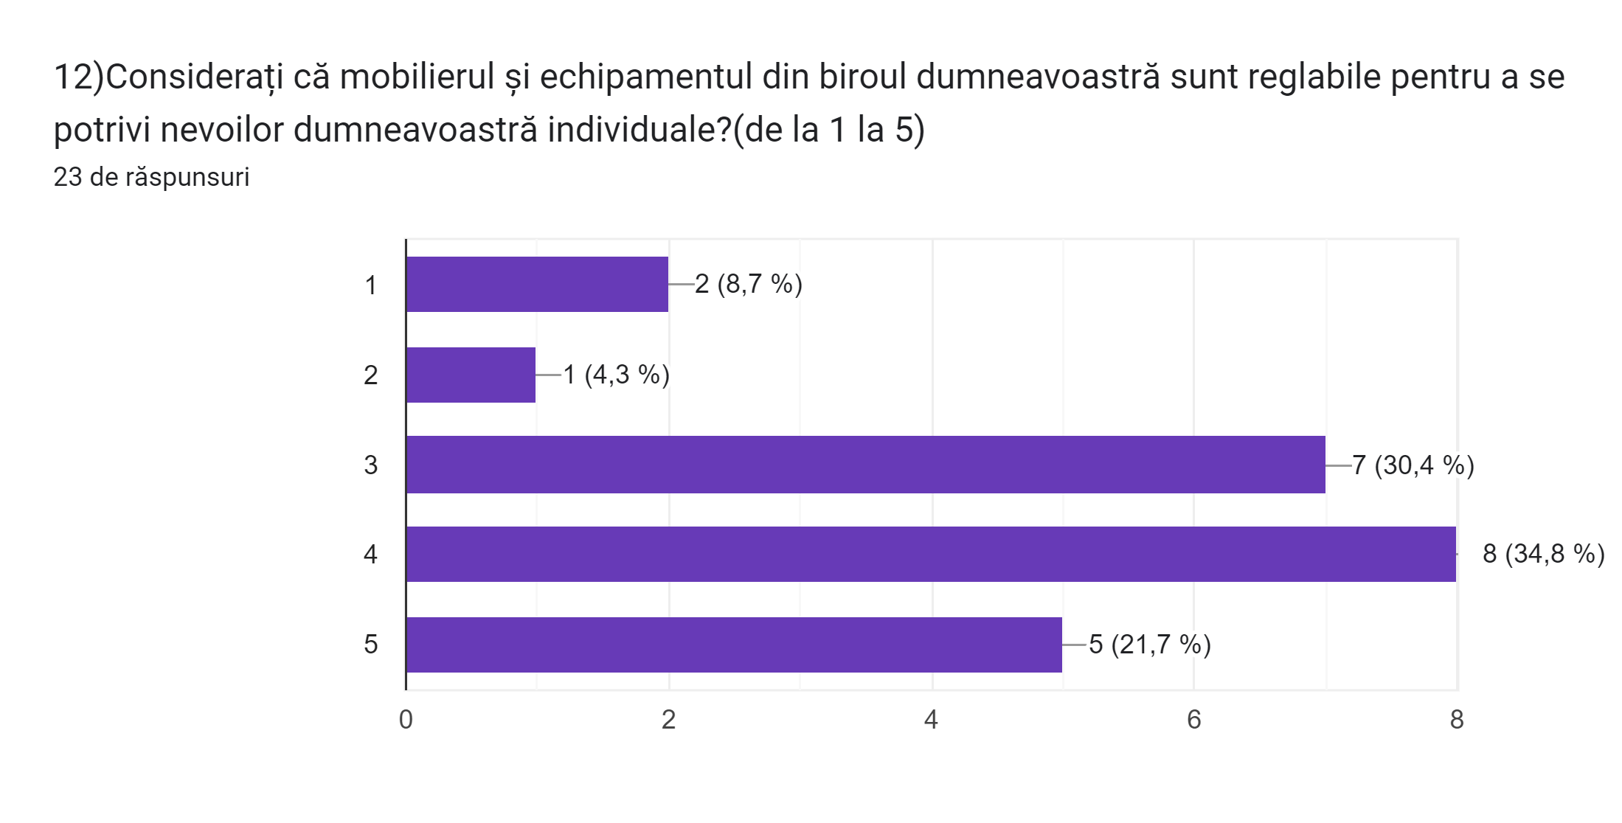
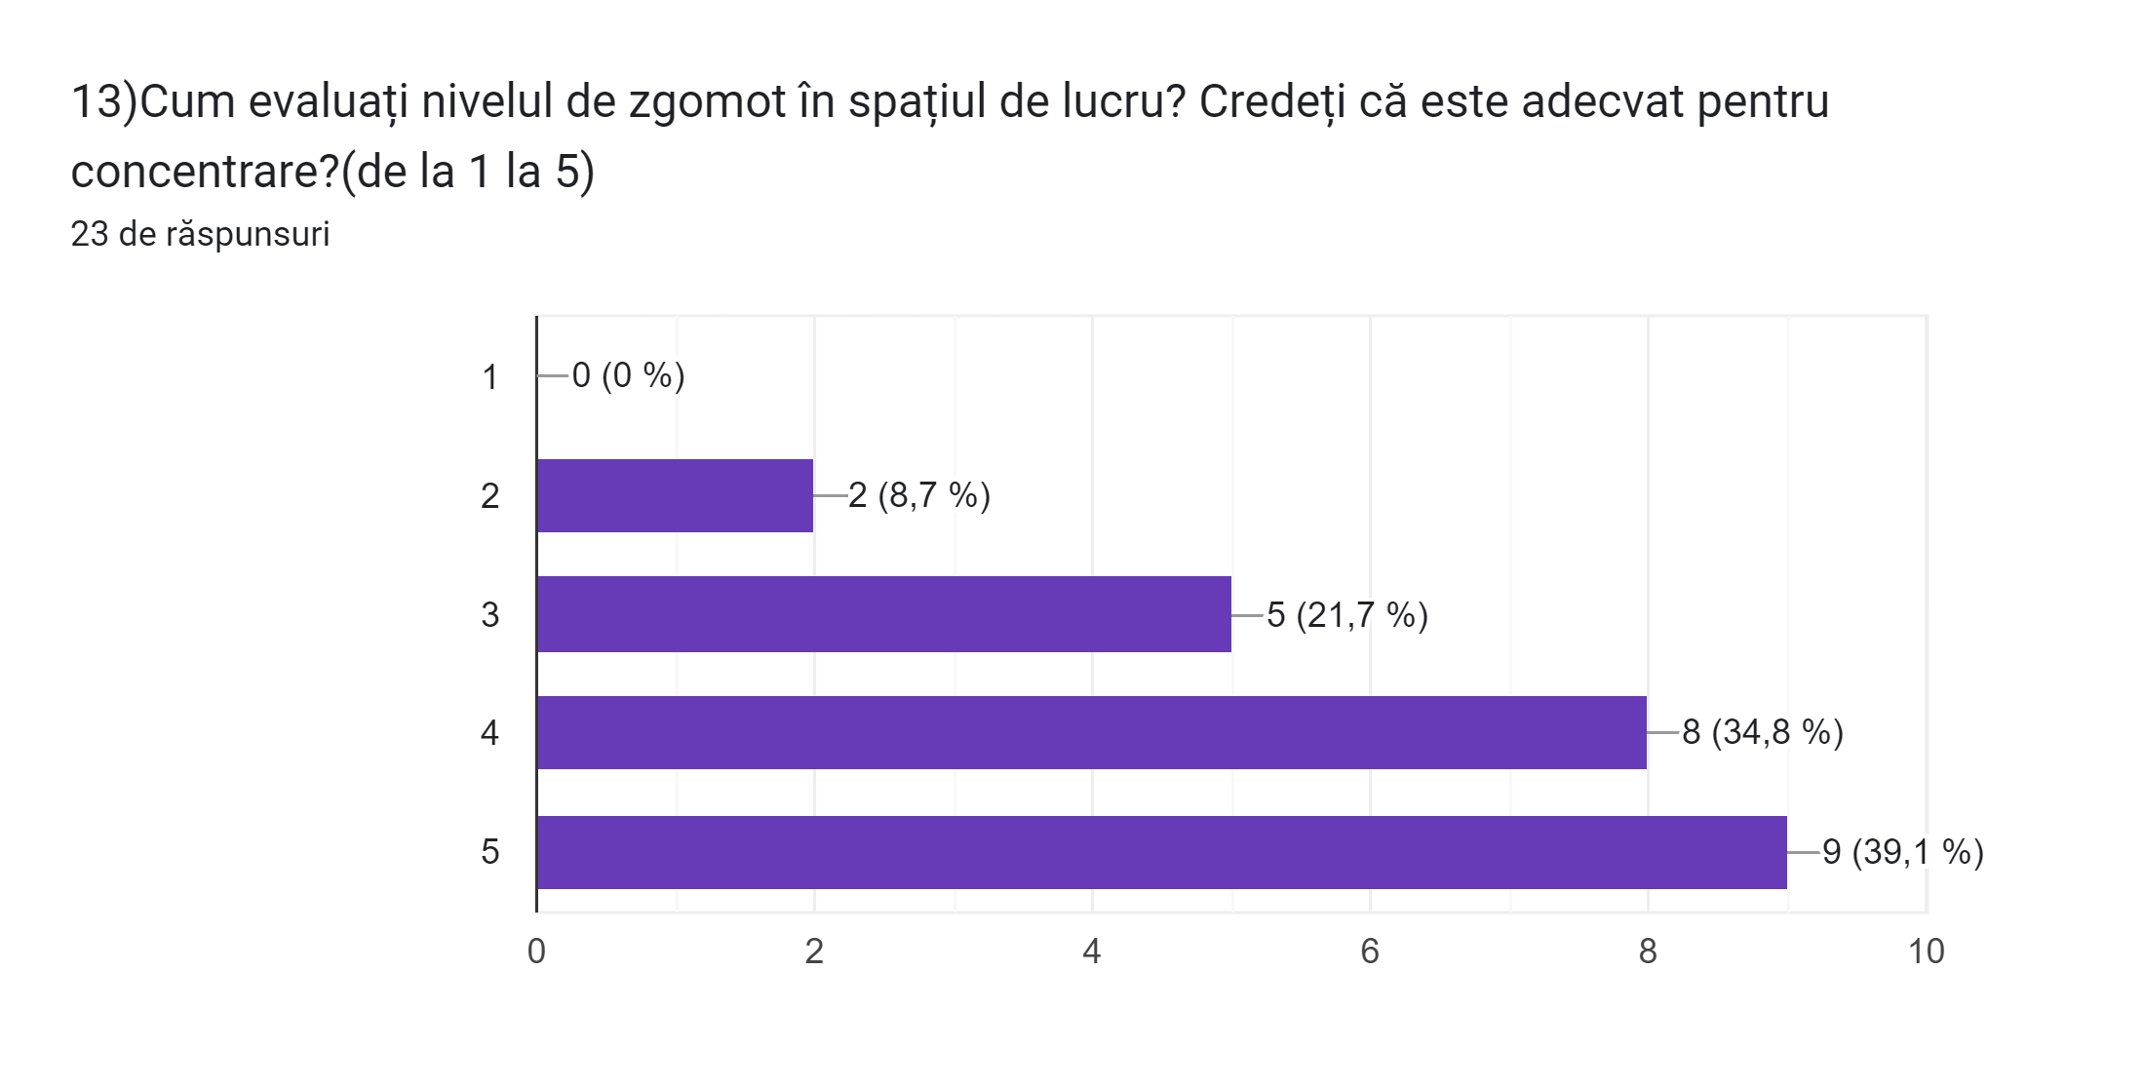
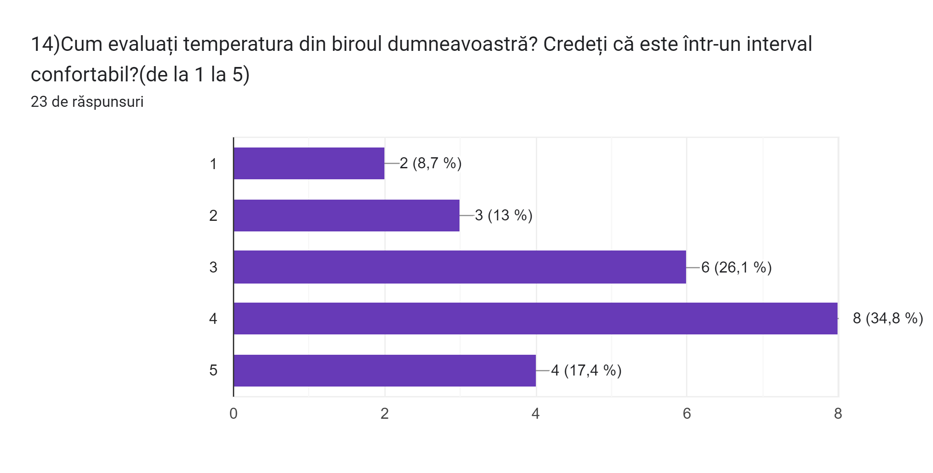
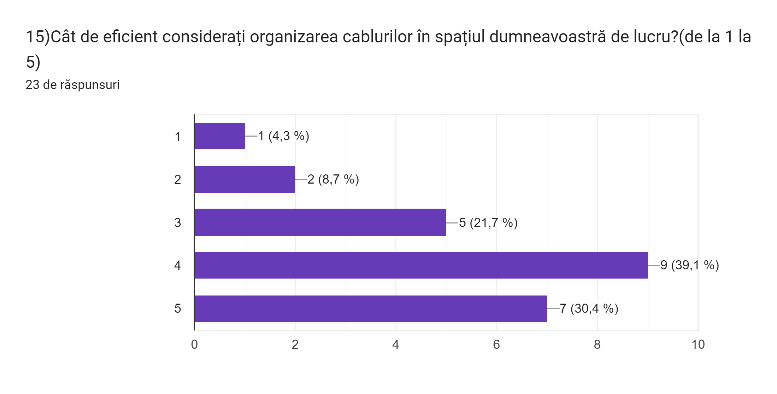
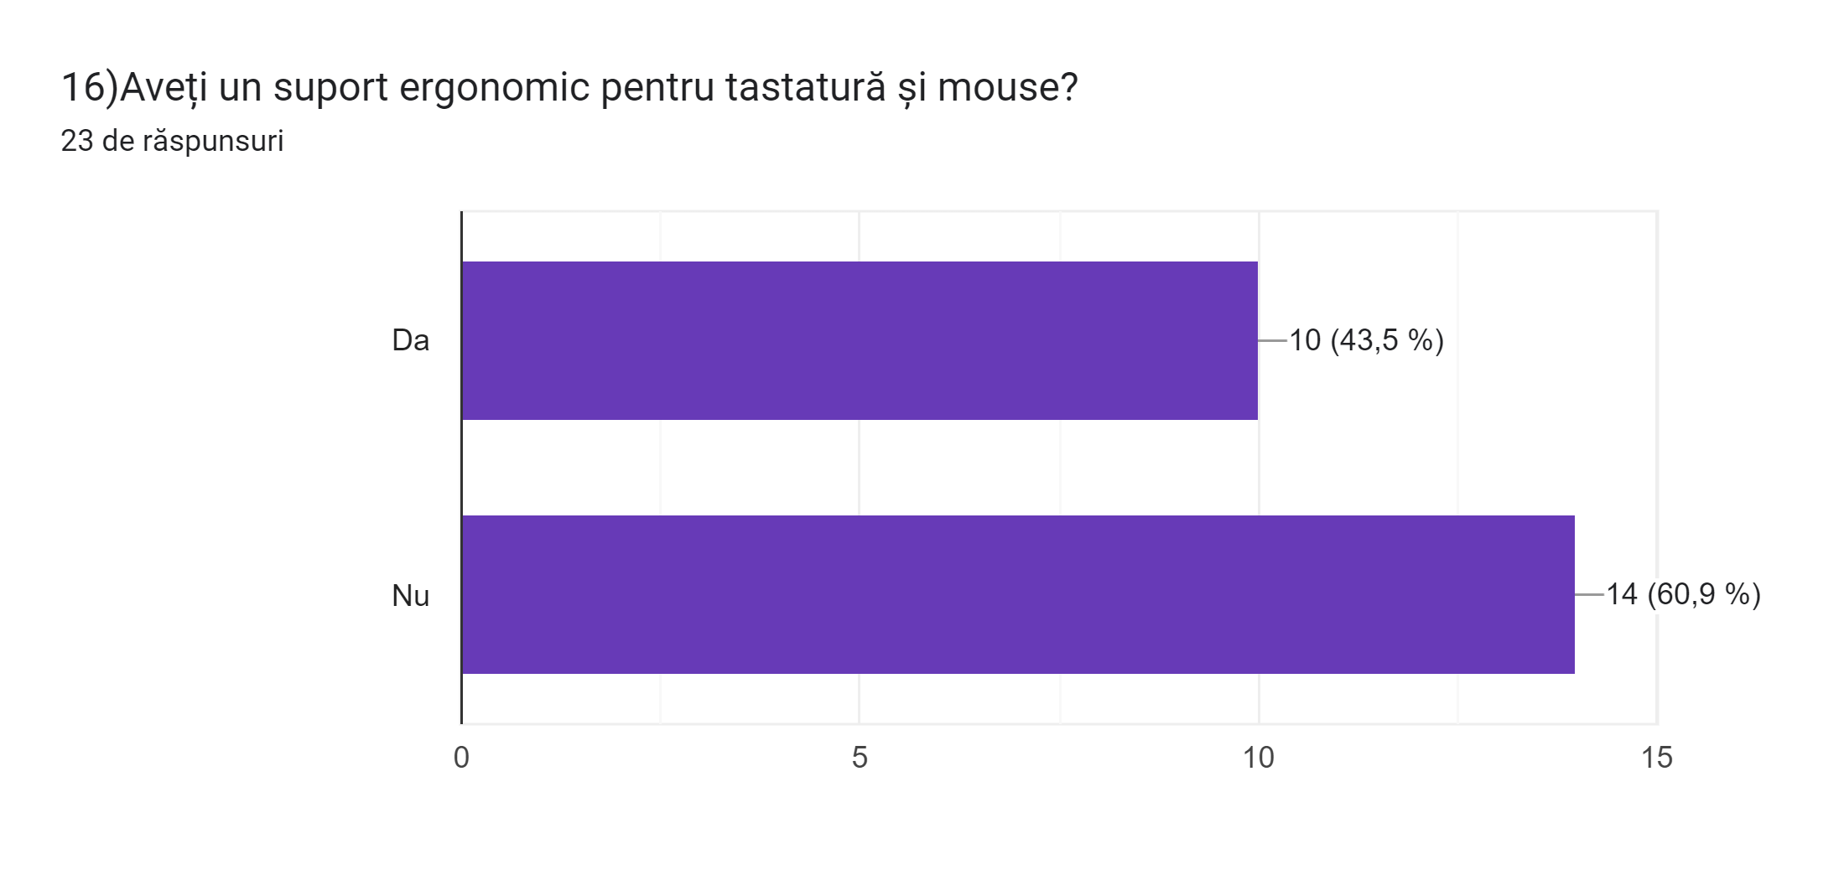
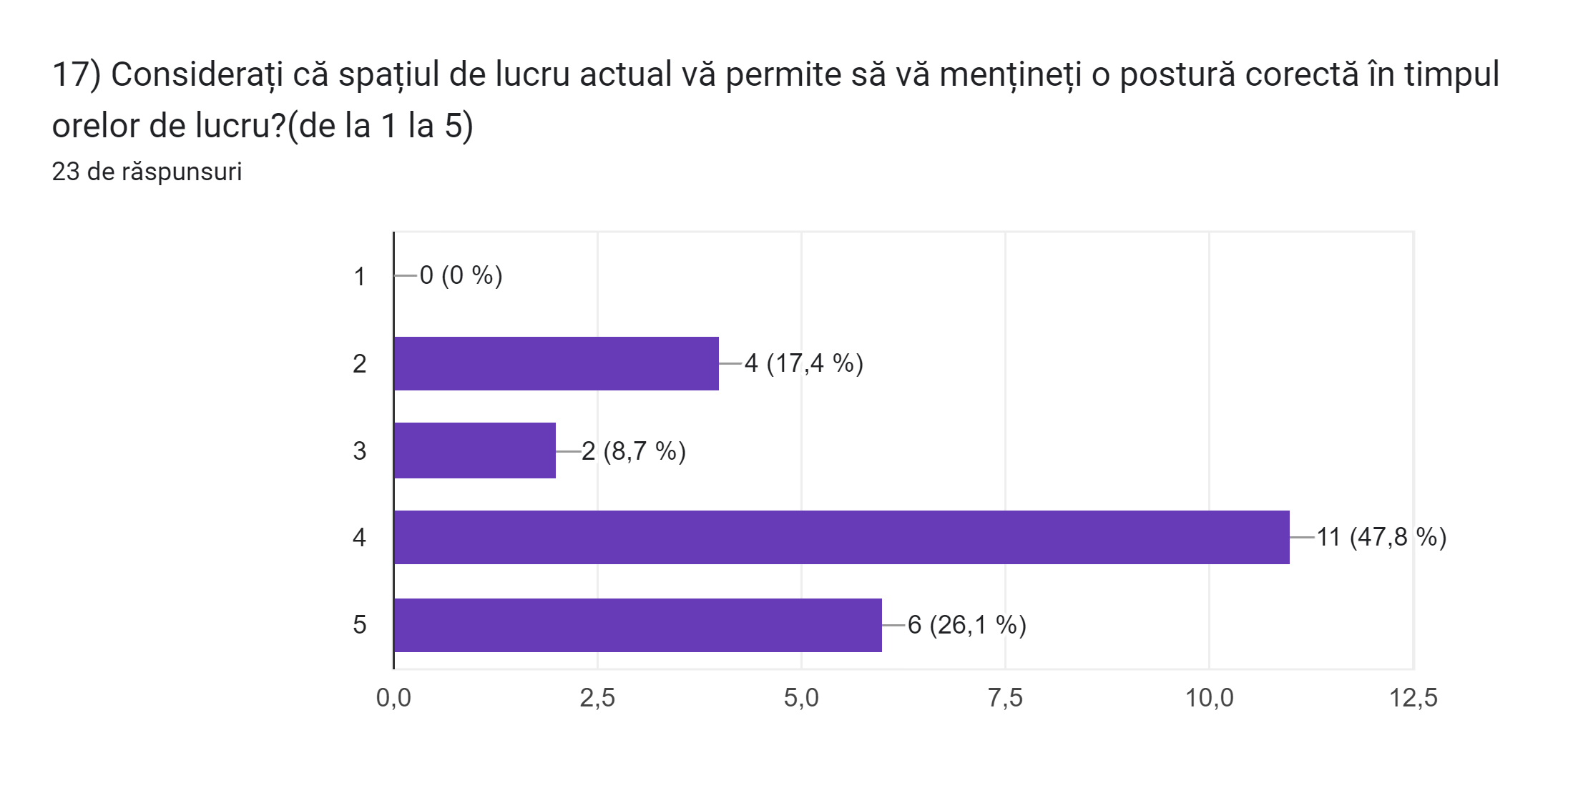

Slide 8
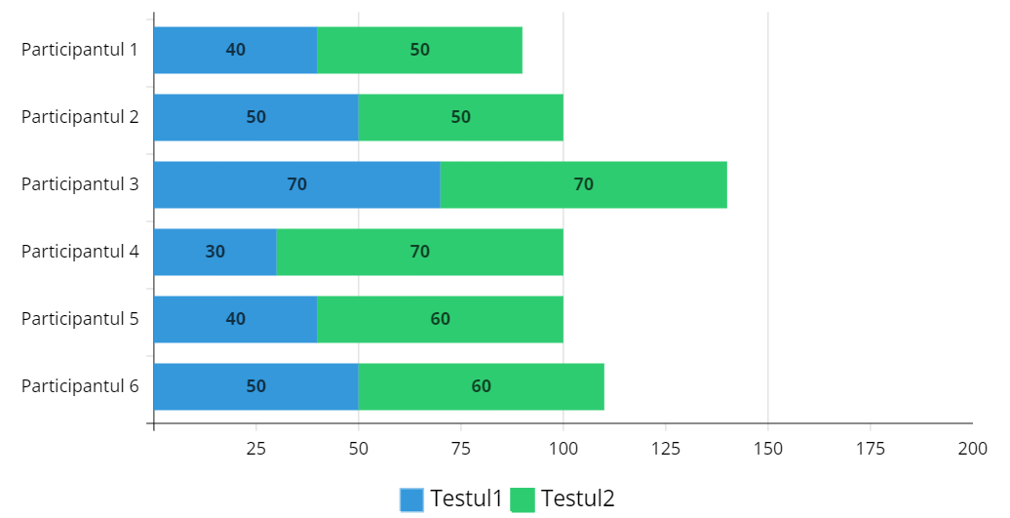
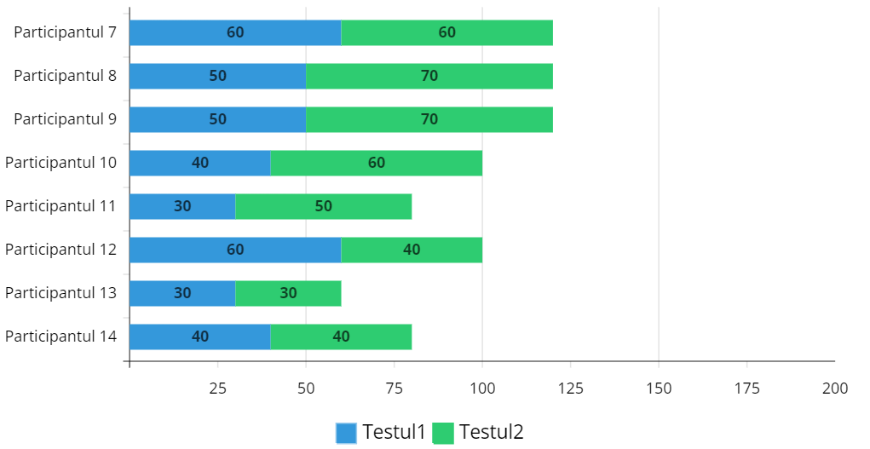
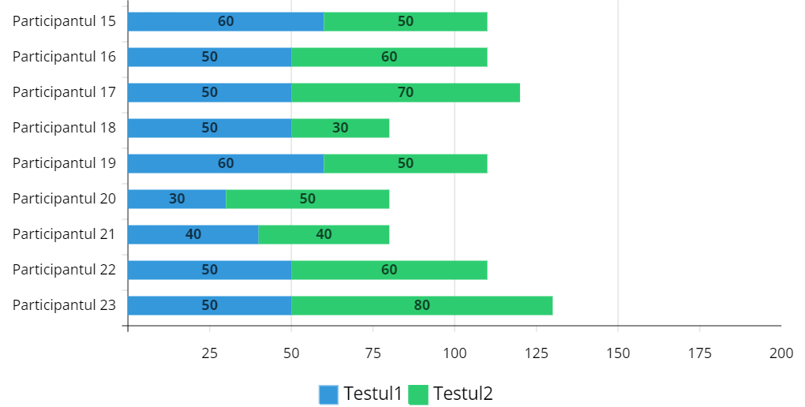

Results of our study - tests
TEST1
-58,15% correct answers
- 10’12’’ average time
TEST2
-69,02% correct answers
- 9’23’’ average time

Slide 9
CONCLUSIONS
The percentage of correct answers increased by 10.87 percent, suggesting a positive impact of the ergonomic instructions provided during the two-week period.
Alongside the improvement in correctness, there was a notable enhancement in time efficiency. The average solving time for the test decreased by 49 seconds, indicating that participants not only performed better but also did so more quickly.
The mention of individual analysis in the graphs suggests that there may be variations in how participants responded to ergonomic guidance.
Overall, the results suggest that providing ergonomic education positively influences both correctness and efficiency in task performance, emphasizing the potential benefits of incorporating ergonomic practices into educational programs, which also was the main objective of this article.

Slide 10
THANK YOU

